Slide 1
Southern Strategy Summary
Growing Together

Slide 2
Southern Strategy Committee
Brad Ott, facilitator
Ken Kenegos
Rita Valenti
Cathy Courtney
Peg Nosek

Slide 3
What makes the South worthy of a strategy?
How is it different from the rest of the country?

Slide 4
Education
http://www.ed.gov/blog/wp-content/uploads/2013/01/Slide4.png

Slide 5
Poverty
http://www.census.gov/prod/2012pubs/acsbr11-01.pdf

Slide 6
Unions
http://www.bls.gov/opub/ted/images/2012/ted_20120130b.png

Slide 7
Health Insurance
http://media.law.uark.edu/arklawnotes/files/2013/07/Leflar-figure5.jpg

Slide 8
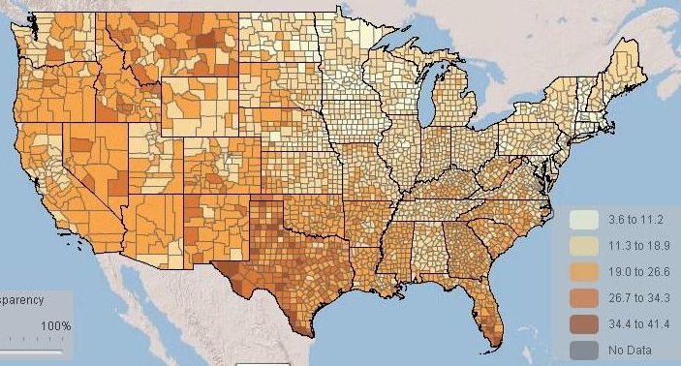
Health Insurance
Percentage of Americans without Health Insurance by County in 2010 (U.S. Census Bureau)
http://www.publicinsightnetwork.org/2012/08/30/counting-the-uninsured-county-by-county/

Slide 9
Infant Mortality
http://www.cdc.gov/nchs/data/databriefs/db120_fig5.png

Slide 10
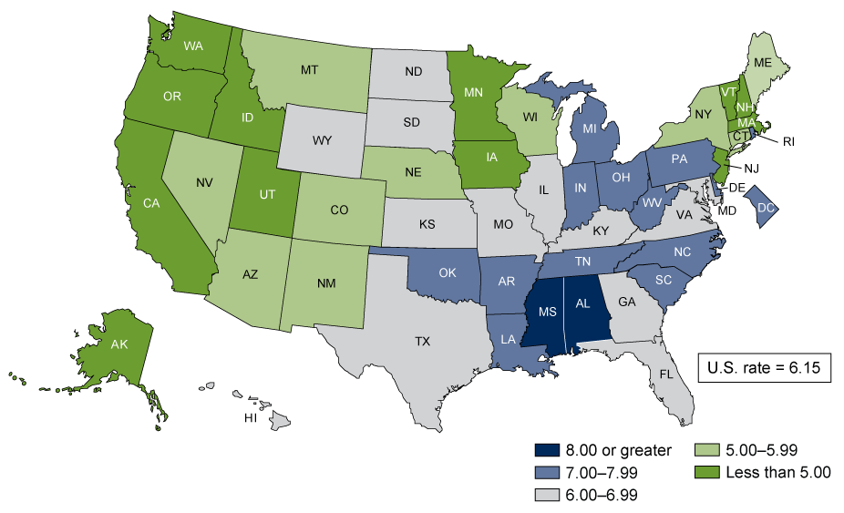
Infant Mortality
Health Insurance
Health is related to more than just health insurance in the current environment.

Slide 11
The Southern Attitude

Slide 12
Living Legacy of White Supremacy
Class Distinctions
Legitimacy of extreme inequality in income, opportunity, and privilege
Tribalism
Feudalism
Patriarchal
Plantation/Slave Mentality
Whites perceive that black people expect to be taken care of
Whites perceive that government is the slave master
Remnants of Civil War disenfranchisement
Blacks disenfranchised by whites
Southern whites disenfranchised by Northern whites

Slide 13
Roots of Neocon Tactics
Willie Lynch, a British slave owner in the West Indies, was invited to the colony of Virginia in 1712 to teach his methods to slave owners there
Don't need to lose valuable stock by hangings
Just use fear, distrust, and envy for control purposes
Make a list of differences, make them bigger, pitch one against the other
"I shall assure you that distrust is stronger than trust, and envy is stronger than adulation, respect, or admiration."
"I guarantee everyone of you that if installed correctly it will control the slaves for at least 300 years. "
Ken Harris 'Black Bottom Entrepreneur‘, http://www.michronicleonline.com/index.php/your-voice/opinion/ken-harris/item/163-the-slave-mentality-after-320-years-are-we-still-on-the-plantation

Slide 14
The New Jim Crow
The War on Drugs
Pipeline to Prison
Mass Incarceration
Voter ID Laws
Redistricting
Public housing
Food stamps
Medicaid

Slide 15
Medicaid
Creates a system of healthcare apartheid
Only 50% of physicians accept Medicaid due to very low reimbursement rates
Waiting lists
Substandard services
Forces people to maintain their poverty status
Prohibits work
Prohibits savings
Discriminates against women and people with disabilities
Institutional bias

Slide 16
Medicaid
People will die in the streets and in back rooms if we don't have it
Portal for other services -- food stamps, housing, attendant care

Slide 17
Medicaid Expansion (as of September 5, 2013)
http://www.plannedparenthoodaction.org/files/8713/7841/9102/9-6-13-US-Map-Medicaid-Expansion-952x690.png

Slide 18
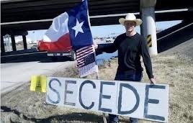
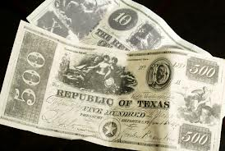
Patriarchal
States’ rights
State chauvinism
Super-nationalist pride
Massive resistance, as seen against school desegregation

Slide 19
Undocumented, Anti-immigrant hostilities
http://www.slate.com/articles/news_and_politics/map_of_the_week/2013/02/map_illegal_immigrant_population_by_state.html

Slide 20
The War on Women
http://www.motherjones.com/politics/2013/03/what-happens-when-you-defund-planned-parenthood

Slide 21
Capitalism on Steroids
Federal block grants for social services and healthcare
Privatization
Prisons
Medicare
Medicaid
Kentucky
Texas
Public Hospitals
Meridian Behavioral Health Systems takeover of Southeast Louisiana Hospital, north of Louisiana, moving all long-term psychiatric patients 200 miles away

Slide 22
Seeds of the New Revolution

Slide 23
Hopeful Trends
Civil Rights Movement and its influence on progressive social movements
Women
Disability Rights
LGBT
South Africa's anti-apartheid movement
Southern history of struggle has taught the whole country
The Mississippi Mound Bayou Project
Medical Committee for Human Rights
Maroon Communities
The Walk for Dignity for Trayvon Martin
immigrant rights marches in the south
Moral Mondays in North Carolina
Textile Workers struggles in the Carolinas

Slide 24
Hopeful Trends
Single-payer solidarity with other movements
Southern Movement Assembly, 300 people gathered in Lowndes County, Alabama focused on what different communities in the South are struggling for – with healthcare access a facet of all statements
Peace movement
Economic justice
The South is turning progressive
A lot of angry people

Slide 25
The Latino Voter
http://www.pewhispanic.org/2012/10/01/mapping-the-2012-latino-electorate/

Slide 26
Five minutes summary on what’s happening in Southern states
Texas
Georgia
Louisiana
Florida
Tennessee
South Carolina
Alabama
Kentucky
Maryland

Slide 27
Breakout Groups
What does our situation look like?
How we can convert the fight for Medicaid expansion into a fight for a real national health system that doesn't exclude anyone?
What opportunities do you see for organizing toward a single payer future?

